Slide 1


Chapter 12
Other Punctuation

Slide 2
❶ The Period
❷ The Question Mark
❸ The Exclamation Point
❹ The Dash
❺ Parentheses
❻ Quotation Marks
❽ The Hyphen
❼ Italics

Slide 3
❶ Uses for the Period
To Punctuate Statements, Commands, and Indirect Questions
Use a period at the end of a statement, a command, and an indirect question.
Use a period, not a question mark, to punctuate a polite request.
Is usually answered by an action rather than a yes or no

Slide 4
To Punctuate Abbreviations
Lowercase. Use periods after most abbreviations beginning with lowercase letters.
a.m. (ante meridiem)
p.m. (post meridiem)
i.e. (that is)
e.g. (for example)

Slide 5
Upper and lowercase. Use periods for most abbreviations containing capital and lowercase letters.
Dr. (Doctor)
No. (number)
Mr. (Mister)
Fri. (Friday)
Exceptions – PhD & EdD
All capitals. For most abbreviations shown in all capital letters, use no periods or internal spaces.

Slide 6
Geographical areas. Use all capital letters without periods or internal spaces.
USA (United States of America)
UK (United Kingdom)
MI (Michigan)
BC (British Columbia)

Slide 7
❷ Uses for the Question Mark
To Punctuate a Direct Question
Use a question mark at the end of a direct question and after a question that is added to a statement.
Is this the order for Lamson, Ltd.?
The meeting is at 9:30 a.m., isn’t it?

Slide 8
❸ Uses for the Exclamation Point
To Express Strong Emotion
Use an exclamation point after a word, phrase, or clause expressing strong emotion.
In business writing exclamation points
are used sparingly.
What a fantastic view! Stop! That door is not an exit!
Oops! I forgot the attachment!

Slide 9
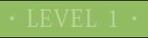
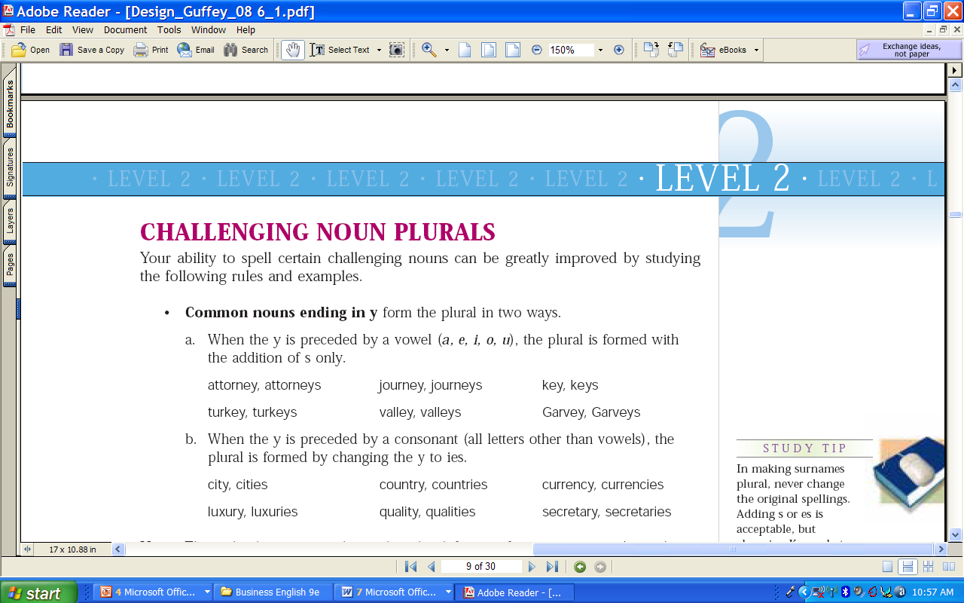
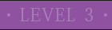
Learning Objectives
Dashes and parentheses

Slide 10
❹ Uses for the Dash
To Set Off Parenthetical Elements With Internal Punctuation
Three employees—Ann, Mike, and Ramon—were honored.
Some of the equipment—desks, telephones, and files—may have to be relocated.

Slide 11
To Set Off a Summarizing Statement
Use a dash (not a colon) to separate an introductory list from a summarizing statement.
Addresses, zip codes, and phone numbers—these are the items we need immediately.

Slide 12
To Attribute Quotation
Use a dash to attribute a quotation.
“A little learning is a dangerous thing.” —Alexander Pope

Slide 13
❺ Uses for Parentheses
To Set Off Nonessential Sentence Elements
Use parentheses to de-emphasize and to set off nonessential sentence elements.
Explanations, references, and directions are often enclosed within parentheses.

Slide 14
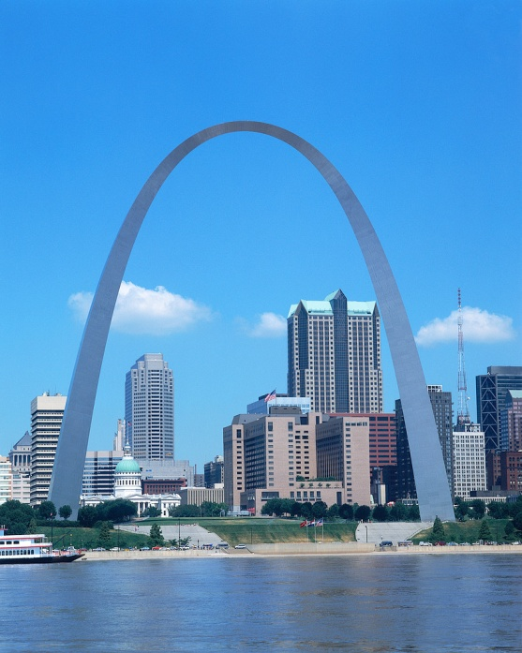
Assembly of the bookcase (see the instruction manual) is easy and quick.
Our income statement (see Appendix A) shows a substantial increase in revenue this year.
You missed the due date (March 15); however, your payment will still be accepted.

Slide 15
Punctuation
Punctuation marks that would normally occupy the position already occupied by a second parenthesis are placed after the parenthesis.
If you attend (April 3), we will vote on the issue.
Forms were filled out for just one individual (James Foster); however, they must be approved.

Slide 16
Punctuating with Parentheses
If the text within parentheses is within a sentence, you can use ? or ! but not a period.
If the text within parentheses is not within another sentence, add whatever punctuation is necessary. Place the punctuation inside the parenthesis.

Slide 17
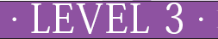
Learning Objectives
Use quotation marks properly, and correctly place other punctuation marks in relation to quotation marks.
Use underscores and italics appropriately.

Slide 18
❻ Uses for Quotation Marks
To Enclose Direct Quotations
Use double quotation marks to enclose the exact words of a speaker or writer.
Professor Hunter said, “You earned a high grade.”
Professor Hunter said that you earned a high grade.
“She was hired on the first of the month,” remarked Ms. Sims. “She receives benefits next month.”

Slide 19
Enclose Titles with Quotation Marks
Use quotation marks to enclose magazine and newspaper articles, book chapters, television episodes, poems, songs, and links in Web sites.

Slide 20
He said, “You should read the article entitled ‘Economics and Recession.’”
Did he say, “You should read the article entitled ‘Economics and Recession’”?
“Did you enjoy,” said Mr. Dornan, “the article entitled ‘Economics and Recession’?”

Slide 21
❼ Uses for Italics
Use italics (or underscores if italics are not accessible) for the titles of books, magazines, pamphlets, newspapers, and other complete published works that contain subdivisions.
America at Work, a new research book, was reviewed positively in The Wall Street Journal.

Slide 22
To Enclose Short Expressions
Slang, words used in a special sense, and words following “stamped” or “marked” are usually italicized.
(Some writers enclose them within quotation marks.)

Slide 23
Words Under Discussion
Two frequently misspelled words are convenience and conscientious.
Words Following “Stamped” or “Marked”
Your letter is stamped Confidential.

Slide 24
To Enclose Definitions
The word being defined should be italicized.
Use quotation marks to enclose definitions of words or expressions.
The word liability is defined as a “debt owed by a business.”

Slide 25

Colons and semicolons are always placed outside quotation marks.
Our supervisor said, “We are eliminating all overtime this month”; therefore, employees must be informed.

Slide 26
Question marks and exclamation points may go inside or outside closing quotation marks, depending on the quotation.
Quotation asks a question
Professor Dooley said, “How many have completed the assignment?”

Slide 27
Sentence, not quotation, asks a question
Did she say, “The meaning of the word imprudent is ‘rude and irreverent’”?
Both sentence and quotation ask questions
Why did Mr. Sims say, “Who used the copier last?”

Slide 28
The Hyphen
Permanent hyphens
Part-time, Full-time
Family titles that contain ex, great, or in-law
Compound numbers such as twenty-two
Use a hyphen in these cases:
Compound noun such as high-rise
Compound adjective such as the following:
I will need a 6-foot ladder to get on the roof of the two-story house.

Slide 29
Punctuating with Quotations, Question Marks, & Exclamation Marks
I asked you this earlier, “Did Mom say, ‘Clean your room’?”
The message board said, “I’ll be spending the weekend at the Morleys’.”
Let’s not panic and yell “Fire!”
Please stop saying, “Don’t worry”!

Slide 30
FAQs
When writing phone extensions, capitalize the first letter and add a comma before and after.
Please call me at (515) 964-6884, Ext. 1234, by March 1.
Complement – Your scarf complements your coat!
Compliment – I like to receive compliments!

Slide 31
Time for Reinforcement Exercises!

